Slide 1




Suicide SKuad
Feature importance ranking contributing to suicide prediction
Steve Nouri
UTS Data Analytics Student
Genomic Analyst
Daniel Han-Chen
UNSW Data Science Student
Saksham Yadav
UNSW Data Science Student

Slide 2

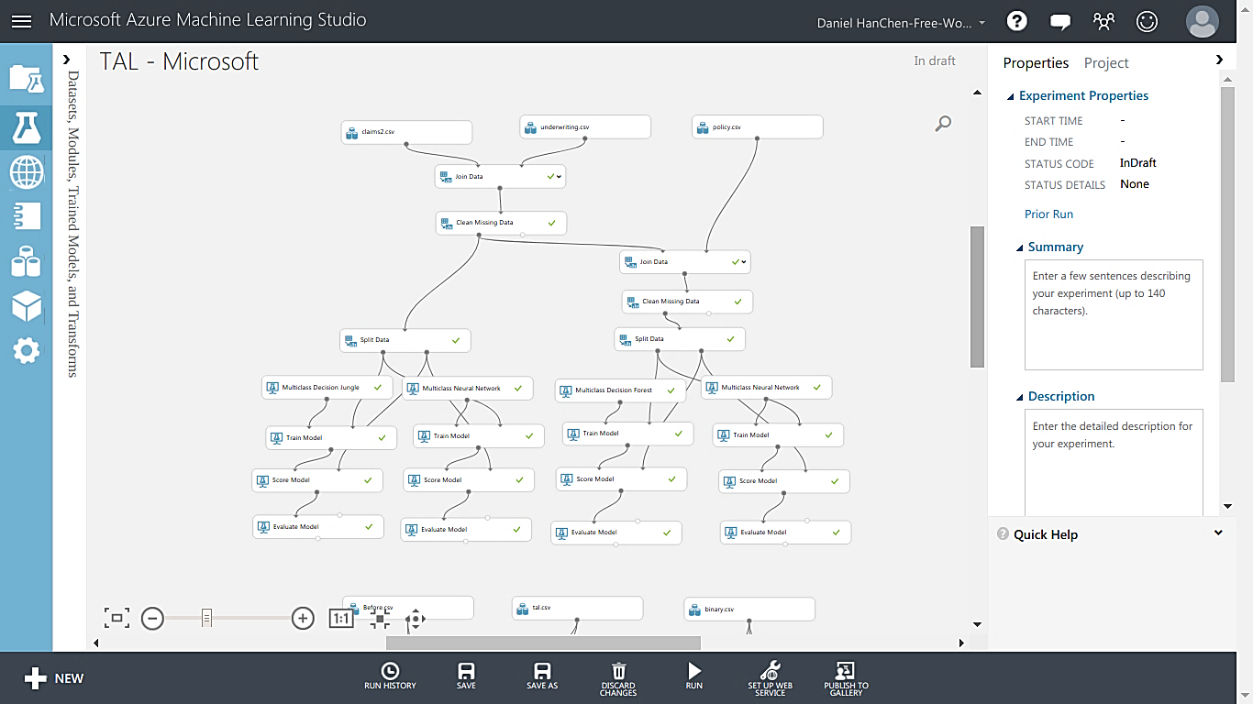

Slide 3
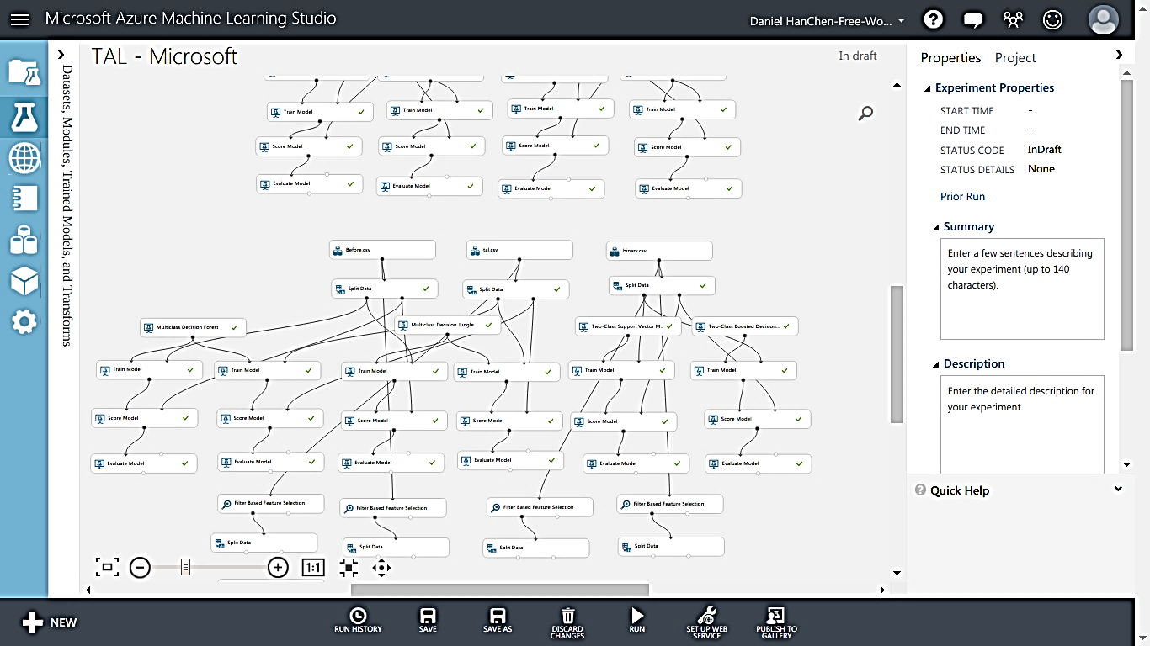

Slide 4

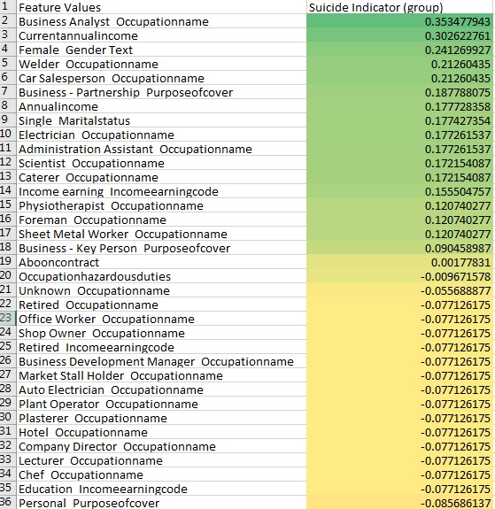
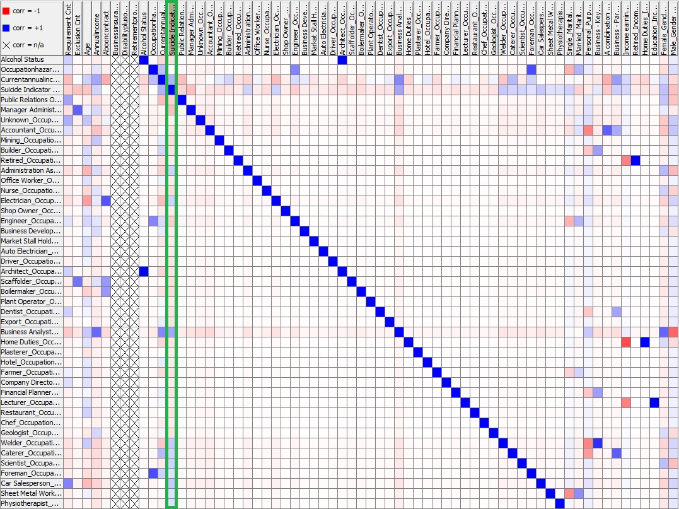

Slide 5

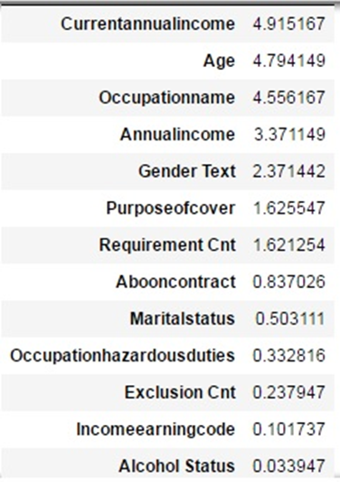
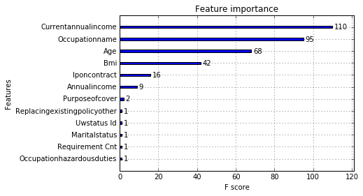
Feature importance generated by XG Boost algorithm (Differentiable Random Forest)
Feature importance generated by custom-made algorithm based on SVM model

Slide 6
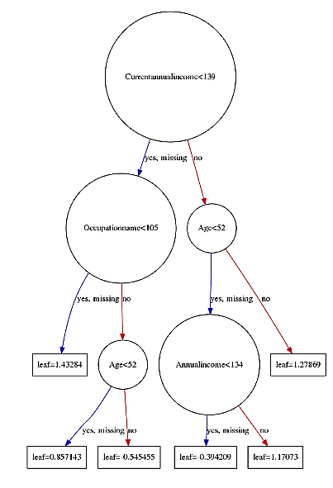
XG Boost Model output (1 tree)

Slide 7
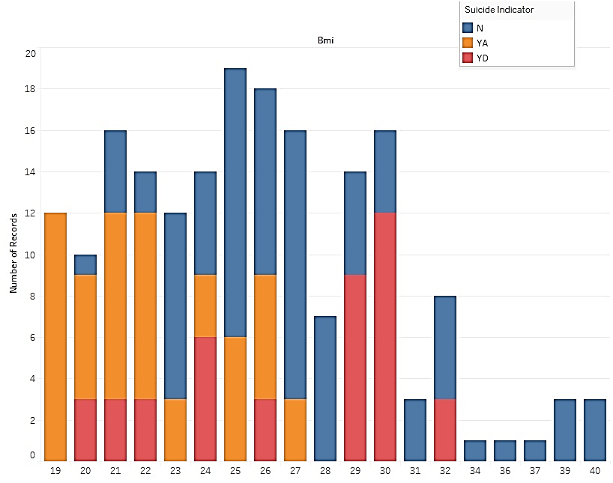
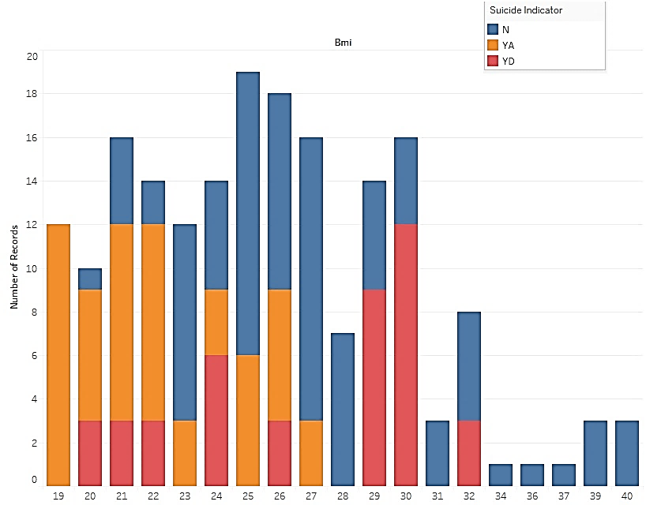
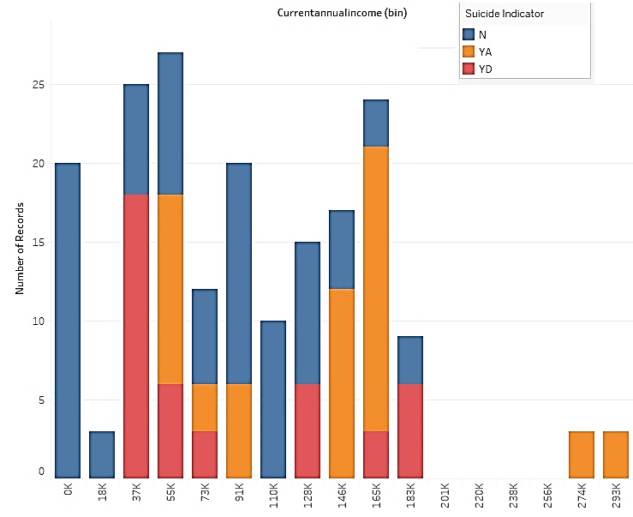
BMI
Current Income

Slide 8
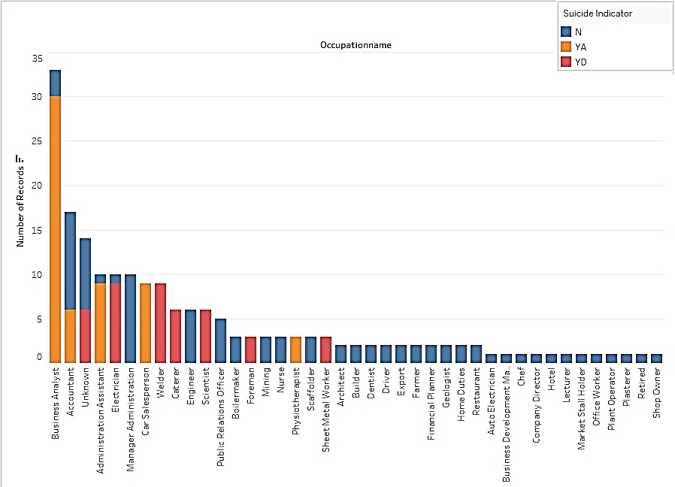
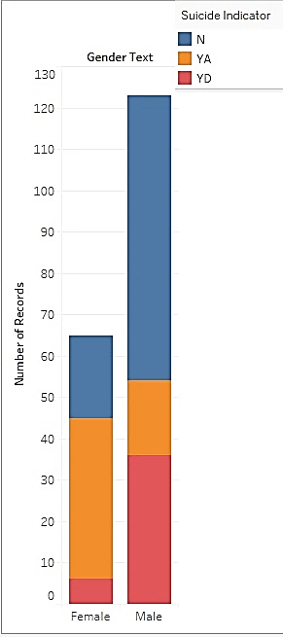
Occupations
Gender

Slide 9
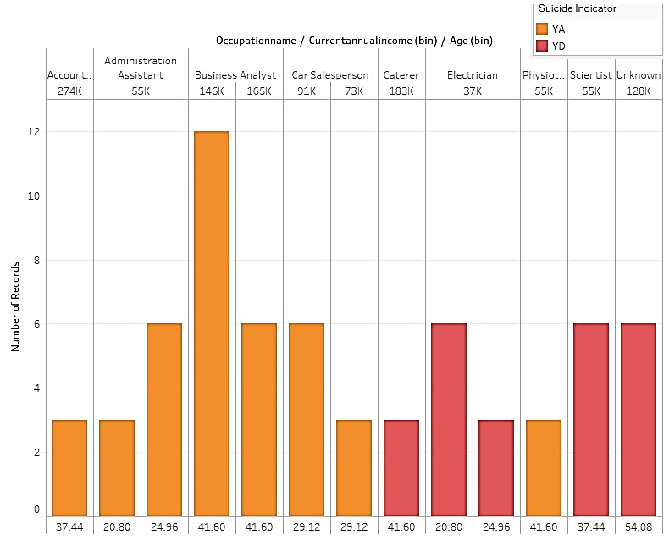
Job, Annual Income, Age

Slide 10
Found people who had more than one policy with duration difference of more than 500 days
Tested our model for final validation:

Slide 11

Suicide Preventative Strategies
Friend, Family,
Employer
Communication
Informal
Psychological
Analysis
Random
Phone Calls
to check

